Slide 1
CS 110 - Professional Practices in IT Instructor Name : Dr Tariq Umer Email : tariqumer@cuilahore.edu.pk

Slide 2
Lecture -8b Expectation of Privacy, and Surveillance Technologies

Slide 3
Topics Covered in this Lecture
Privacy Protection Law
Role of Privacy Implementation Officers
Our Social and Personal Activity

Slide 4
Learning outcomes of this Lecture
To understand the Privacy Protection Law
Understanding the Role of Privacy Officer
To know different Social Privacy issues

Slide 5
Privacy Protection and the Law
Systems collect and store key data from every interaction with customers
Many object to data collection policies of government and business
Privacy is a
Key concern of Internet users
Top reason why nonusers still avoid the Internet
Reasonable limits must be set

Slide 6
The Right of Privacy
Definition
“The right to be left alone—the most comprehensive of rights, and the right most valued by a free people”
“The right of individuals to control the collection and use of information about themselves”

Slide 7
The Right of Privacy (continued)
Legal aspects
Protection from unreasonable intrusion upon one’s isolation
Protection from misappropriation of one’s name or likeness
Protection from unreasonable publicity given to one’s private life
Protection from publicity that unreasonably places one in a false light before the public

Slide 8
Cont.
Government Accountability Office (GAO) - monitors government's privacy policies:
Mission is to support the Congress in meeting its constitutional responsibilities and to help improve the performance and ensure the accountability of the federal government for the benefit of the American people.

Slide 9
The Fourth Amendment
US constitution protects a right to privacy from government intrusion. (even Europe)
It requires that the government have probable cause for the search and arresting (The act of taking of a person by force).
Federal privacy rules allow law enforcement agencies to access medical records without a court order.
The USA PATRIOT Act passed after (9/11) eased government access to Personal info with out court order.

Slide 10
Cont.
PROBLEM: weakening factor for 4th amend. : using new technology govt. can search homes with out physically entering into them.
Search home – with out entering them
Search persons – from distance with out our knowledge
Extract all the data -- on cell phone (even deleted passwords) in 2 minutes ☹

Slide 11
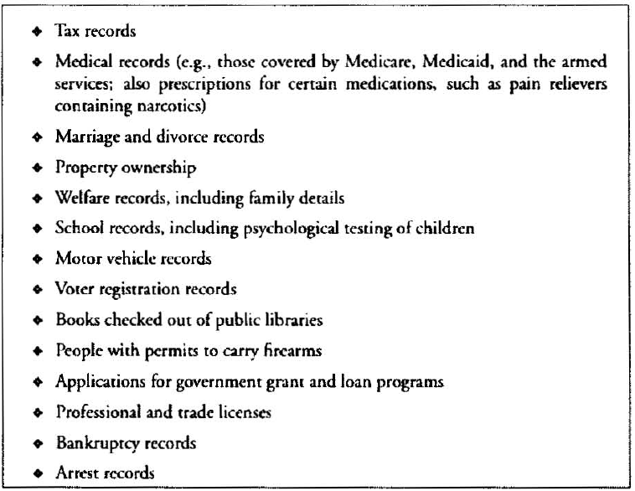
Government databases with personal information

Slide 12
Search and Seizing of Computers and Phones
National Association for Advancement of Colored People (NACCP)
The NAACP’s membership list was not on a computer in the 1950s. It undoubtedly is now. SC ruling against the Alabama state.
Privacy in group association may be essential to preservation of freedom of association, particularly where a group adopts disagree beliefs.
4th am. Requires search warrants be specific about the Object of the search or seizing.
Court says officers allowed to observe situation in plain view and report if suspect found.
Amount of info in plain view at home is smaller than computer at business place.
PROBLEM: Access computer is serious threat to privacy, liberty, and FOS

Slide 13
Plain View
the rule that a law enforcement officer may make a search and seizure without obtaining a search warrant if evidence of criminal activity or the product of a crime can be seen without entry or search. Example: a policeman stops a motorist for a minor traffic violation and can see in the car a pistol or a marijuana plant on the back seat, giving him "reasonable cause" to enter the vehicle to make a search.

Slide 14
Cont.
Interpretation of information in plain view
All un encrypted files on Phones and Laptops-invites abuse.
Court view: if officer see evidence of another crime at plain view, the officer may seize and use it. Could be used for “fishing expeditions” for other information (An investigation undertaken in the hope (but not the stated purpose) of discovering information).
PROBLEM: Fishing expeditions - Crosses 4th am that “Warrant be Specific”

Slide 15
Cont.
Phones and Laptops:
Police can search an arrested person (with out warrant) and examine its property on the person or within his reach.
Can mobile phones be searched ? they may contain proprietary/confidential info e.g. lawyer’s phone.
Vast collection of info on phone is kind of info 4th am. is intended to protect.
Ohio’s SC + Judge Ruling: Searching an arrested persons phone (retrieving info) with out search warrant is illegal as people have expectation of privacy for their phone contents
California SC ruled: info retrieval is permitted as phone is personal property found on arrested person.

Slide 16
Video Surveillance and Face recognition
People aware surveillance areas (banks, convenience stores, prisons, gambling casinos, traffic and cab drivers)
After 2001 terrorist attacks, installation of high zoomed cameras ½ mile range.
Spy Surveillance: Cameras + face recognition apps violate civil liberty issues.
Police in Tampa Florida scan faces of 1lac fans and employees in Super Bowl (snooper/spy). Then matches computer files criminal matches in their DB of suspects.
In two years of no wanted recognized. (Face rec poor accuracy in 2001)

Slide 17
Chief privacy officers
Companies are increasingly appointing CPOs to have a central point of contact for privacy concerns
Role of CPO varies in each company
Draft privacy policy
Respond to customer concerns
Educate employees about company privacy policy
Review new products and services for compliance with privacy policy
Develop new initiatives to keep company out front on privacy issue
Monitor pending privacy legislation

Slide 18
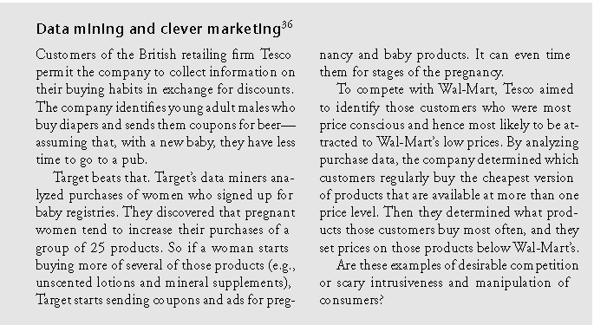
Case study

Slide 19
Our Social and Personal Activity
Social Networks- What We do
Personal information in blogs and online profiles
Pictures of ourselves and our families
File sharing and storing
Is privacy old-fashioned?
Young people put less value on privacy than previous generations
May not understand the risks
Social Networks – What they do
Responsibility of free services
Life in clouds

Slide 20
Location Tracking
Global Positioning Systems (GPS)
Computer or communication services that know exactly where a person is at a particular time.
Cell phones and other devices are used for location tracking and provide details to Profiles and Records Business and Gov.
Collected data could be PROTECTED.
Customer traffic patterns could be positively used but “Location emitting tickets” are better anonymous.
Who is at bar ? Face recognition cameras.
Tools for parents: RFID (Radio Frequency Identification Device) Tags (chip + antenna) can be monitored 100 of feet away
Pros and cons?

Slide 21
A Right to be Forgotten
Legislators and privacy advocates are promoting a legal right to demand that websites remove material about oneself as a legal and ethical right.
Complying with the request could be ethically acceptable and admirable but not ethically obligatory.
Some companies provide free services on the cost of using our data and some give totally free services or at discount on viewing ads.
Right to be forgotten could be taken as negative right (liberty: to stay off internet) or a positive right (claim: removal of posts). Can conflict FOS?
Other may not write about a person or exchange specified information about the person – information gained with out violating any of the person’s rights.
Parents may request legally to remove unethical contents posted by their children.

Slide 22
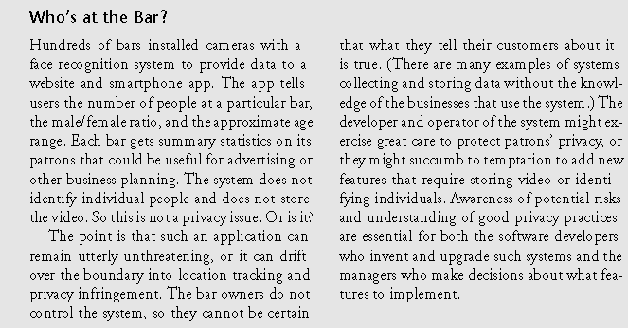
Location Tracking

Slide 23
(cont.)
Stolen and Lost Data:
Hackers
Except for hackers, these are not new to computer technology. Before computers, files were stolen, receipts were stolen, information was requested under false pretenses and employees were bribed. But, with computers, the extent and impact have grown.
Physical theft (laptops, thumb-drives, etc.)
Requesting information under false pretenses (false appearance)
Bribery (The practice of offering something usually money in order to gain an outlawed advantage) of employees who have access

Slide 24
Discussion Questions
Is there information that you have posted to the Web that you later removed? Why did you remove it? Were there consequences to posting the information?
Have you seen information that others have posted about themselves that you would not reveal about yourself?

Slide 25
Assignment 1
Keeping in view the Key Privacy Issues search the web / newspapers and give examples / real life cases for each type issue.
Search for Privacy Protection Laws in Pakistan made/ give reference table for these Laws. Act and its implementation.

Slide 26
End of Lecture 3

